Slide 1


SRMS: Student Record Management System
SRM University-AP

Slide 2
INTRODUCTION
This project presents a simple and efficient console-based Student Management System developed using the C programming language to automate student record handling and reduce manual errors. The system uses text files for secure data storage instead of a database, making it lightweight and easy to deploy. It supports user authentication with role-based access for Admin, Staff, and Guest to ensure data security. The application allows complete CRUD operations on student records through a user-friendly, menu-driven interface and follows modular and maintainable coding practices, making it ideal for small institutions and academic learning environments.

Slide 3

Objectives
Key goals for the system
Secure System
Role-Based Authentication
Data Persistence
The primary objective is to create a secure system that protects user data through robust authentication mechanisms, ensuring only authorized personnel can access sensitive information.
Implementing role-based authentication allows different access levels for Admin, Staff, and Guest users, enhancing system security and ensuring that users can only perform authorized actions.
Utilizing file handling techniques, the system maintains data persistence, allowing records to be stored and retrieved efficiently, ensuring reliable access to student information over time.
3

Slide 4
System Modules
Overview of key system components
Login & Authentication
Menu Module
Student Record Module
The Login & Authentication module ensures that users provide valid credentials, verifying their identity against stored records to control access based on their assigned roles.
The Menu Module facilitates user navigation, displaying options tailored to Admin, Staff, or Guest roles, enabling access to specific functionalities based on user permissions.
The Student Record Module manages all student data operations, allowing users to perform CRUD actions, ensuring data integrity and persistence through file handling and validation processes.
4

Slide 5
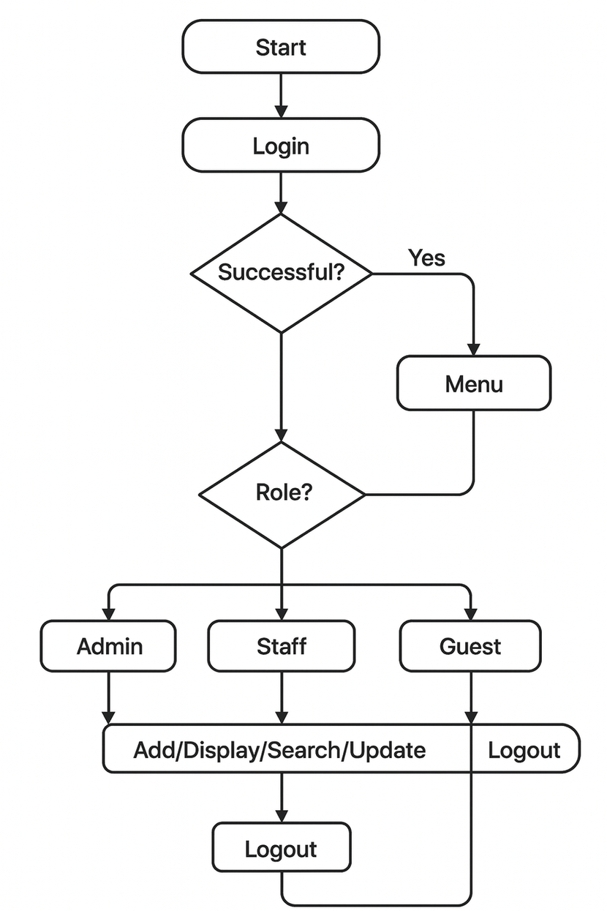
Methodology Overview: System Operations
The system follows a structured and reliable methodology for managing student data. When the application starts, it first performs user authentication, where valid login credentials are required to access the system. The entered credentials are verified by comparing them with records stored in a file. Upon successful login, the user is presented with a role-based menu that displays permitted actions such as add, view, search, update, or delete. Based on the selected option, the corresponding modular function is executed. All student information is read from or written to text files, which serve as the primary storage. The output of each operation is immediately displayed on the console, and the process continues in a loop until the user chooses to log out and safely terminate the program.

Slide 6
Data Flow Diagram
Program Initialization
User Login
Role Verification
Menu Operations
The program begins with initialization, setting up necessary resources and preparing the environment for user interaction and file management.
Users enter their credentials in the login phase, which checks against stored data to authenticate access and ensure security.
Following successful login, the system performs role verification, determining the user’s permissions and presenting a tailored menu based on their role.
The final step involves menu operations, where users can execute various functions such as adding, viewing, or modifying student records, culminating in user logout.

Slide 7

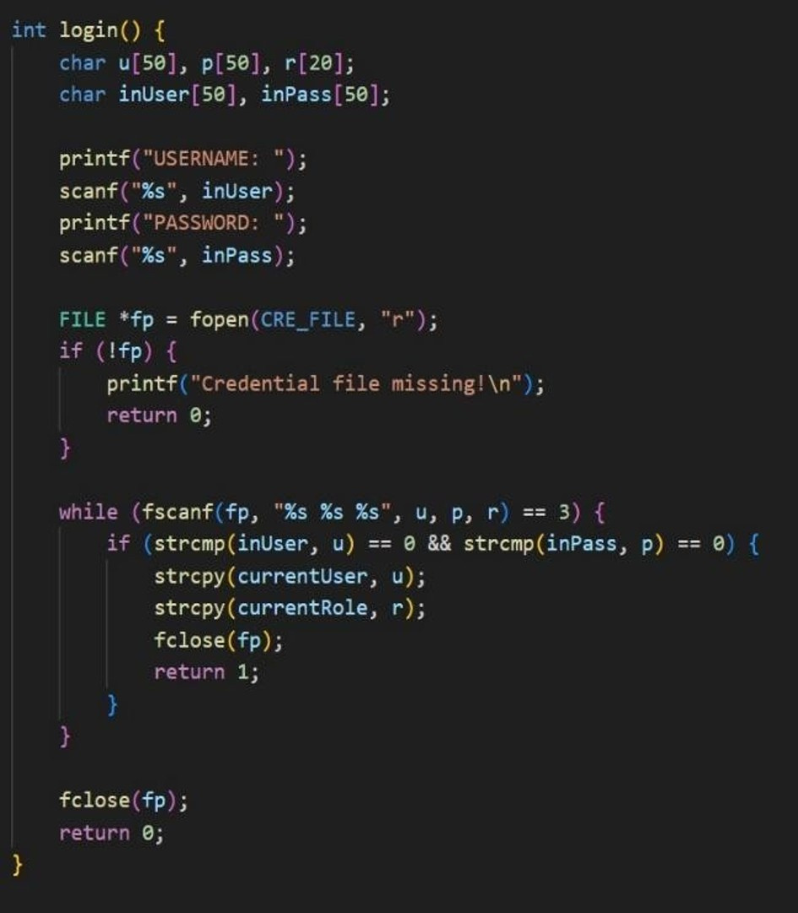
Login Menu Functionality
The login menu verifies credentials stored in credentials.txt, ensuring secure access. Role assignment enables differentiation between Admin, Staff, and Guest, streamlining user experiences and functionalities for each role.

Slide 8
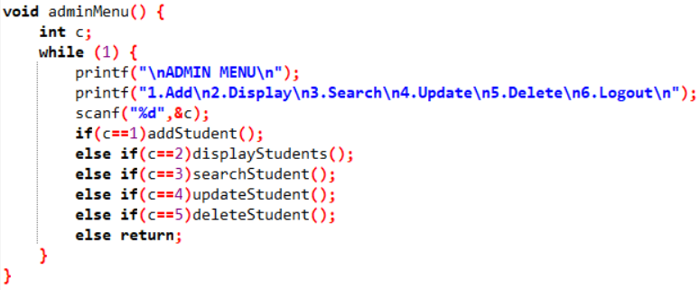
Admin Menu Implementation
The Admin Menu provides full control over student records, enabling actions such as adding, displaying, searching, updating, and deleting entries. This menu operates in a persistent loop until the user logs out.

Slide 9
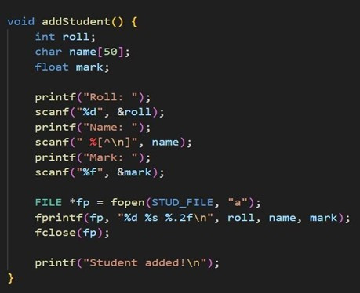
Adding Student Records
The system allows users to input essential details like roll number, name, and marks, which are then securely appended to the student.txt file for persistent storage and retrieval.

Slide 10

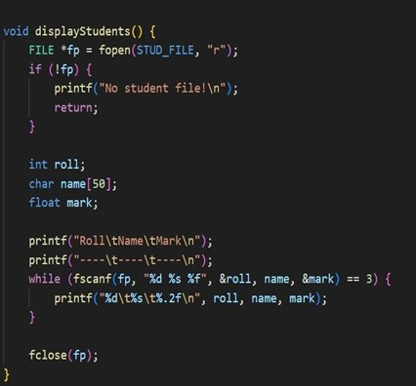
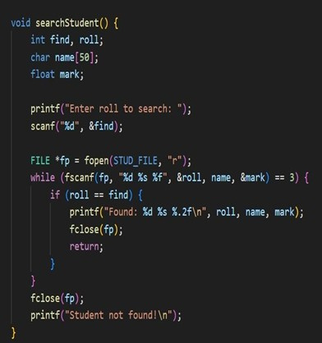
Display and Search Functions

Slide 11
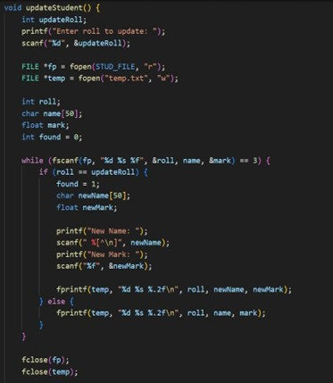
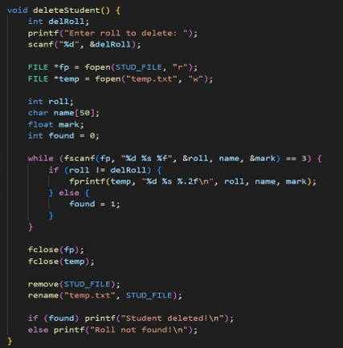
Update and Delete Functions

Slide 12
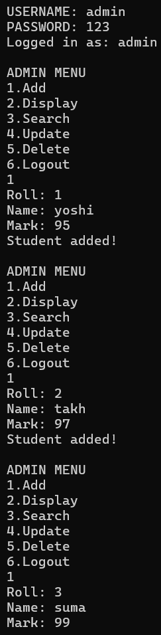
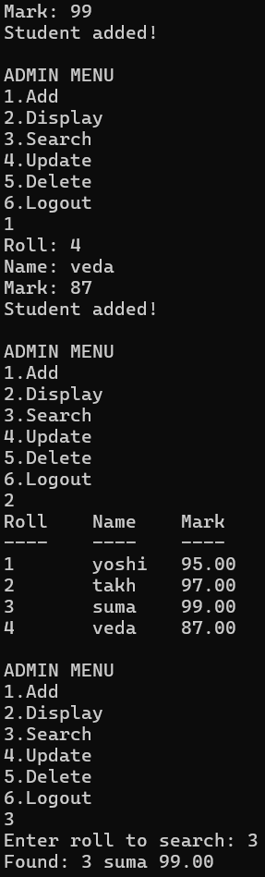
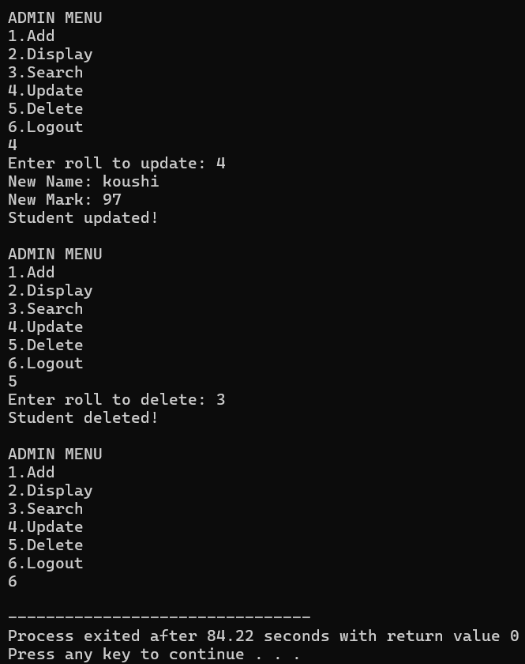
Code and Outputs Overview
This section illustrates the file structures of student.txt and credentials.txt, showcasing how data is organized and stored, ensuring efficient access and retrieval for the student management system's operations.

Slide 13

Conclusion and Future Directions
The SRMS represents a secure, modular, and efficient approach to student record management, illustrating core C programming concepts. Future enhancements may include database integration and GUI development for improved usability.
We extend our sincere gratitude to SRM University-AP and the faculty for their invaluable guidance. Tools utilized include a C compiler and a text editor to develop the project effectively.

Slide 14


Thank You
Presented by
P.SRIVEDA AP24110011270
N.YOSHITHA AP24110011292
SK.TAKHREEM AP24110011299
M.SUMANVITHA AP24110011366
P.KOUSHIKA AP24110011375
Questions and Discussion Welcome

